Slide 1

Grayscale Image Colorization
Illuminating Darkness

Slide 2

Team Members
Ahmed Hamdy
Ahmed Kamal
Ahmed Mostafa
Ahmed Nasser

Slide 3
Supervision
Dr. Dina Khattab
TA. Nora Youssef

Slide 4

Agenda
Introduction
Survey
System Architecture
Dataset
Experiments
Results “Demo”
Conclusion
Future Work
Tools
References

Slide 5
Introduction
Problem Definition
Motivation
Objective

Slide 6
Introduction
Colorization — adding colors to gray-scale images .
The underlying issue is that the resultant image needs to be perceptually meaningful, and visually appealing.

Slide 7
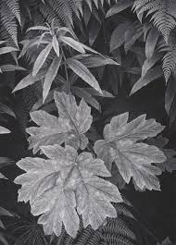
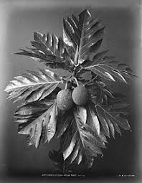
Problem Definition
Automated image colorization is an ill-posed problem, as two objects with different colors can appear the same on grayscale image .

Slide 8

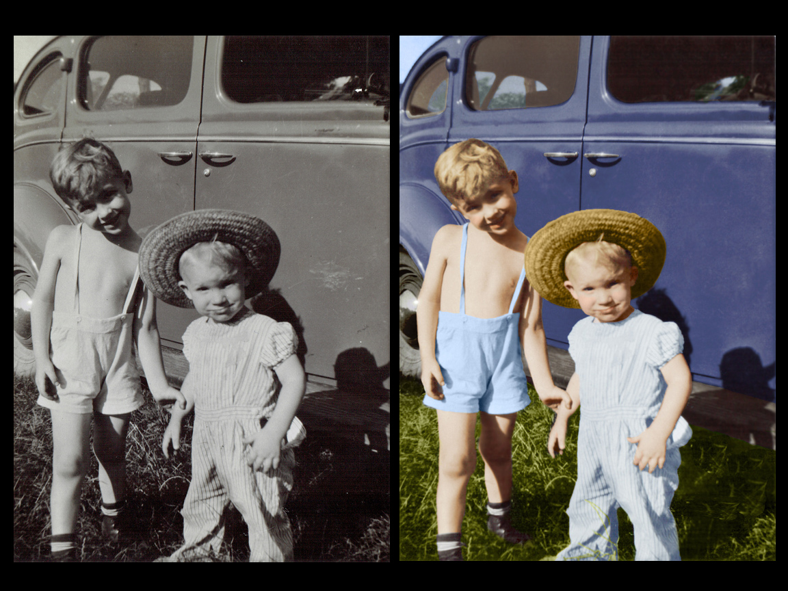
Problem in terms of input & output Input : Grayscale image.. Output : Colorized version of the grayscale image..

Slide 9
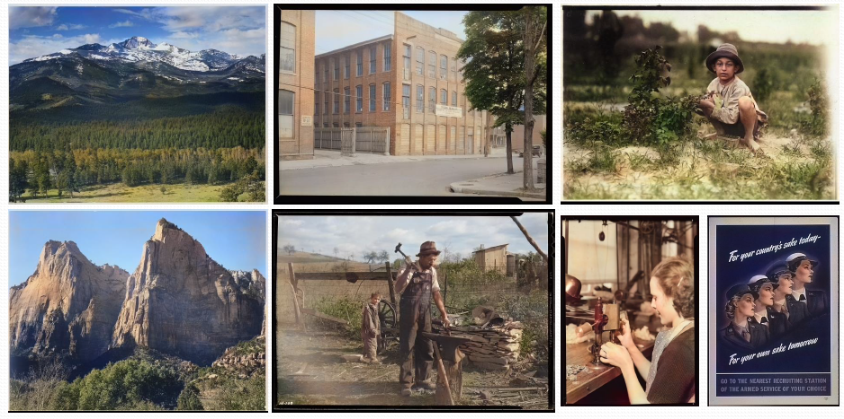
Motivation

Slide 10
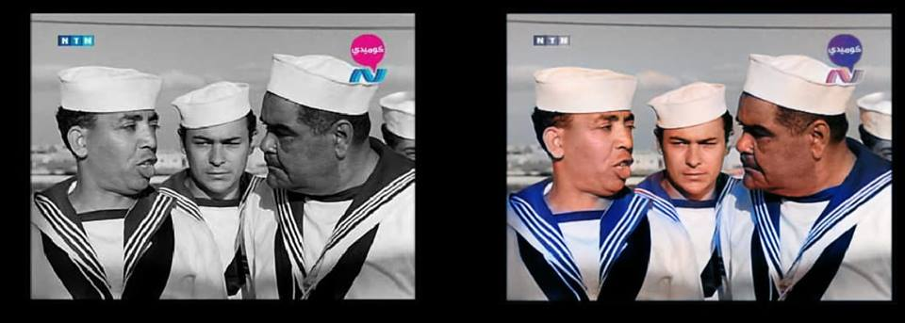
Motivation
For Cinematography..

Slide 11
Objective
Developing an application to colorize grayscale images without any user interaction.

Slide 12
Survey
Simi-Automated Methods
Automated Methods

Slide 13
Semi-automated methods : methods that requires user interaction.
Paper | Authors | Year | Technique
Transferring Color to Greyscale Images | Welsh, Klaus Muller | 2002 | Using reference image
Automatic Image Colorization Via Multimodal Predictions | Charpiat et al | 2008 | Using reference image
Colorization Using Optimization | Levien et al ,Dani Lischinski | 2004 | Using Color “Scribbles”

Slide 14
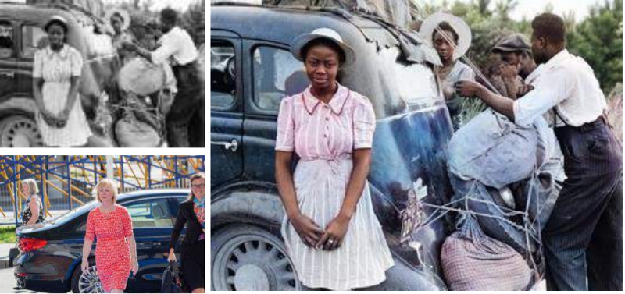
Semi-Automated Methods
Using reference image :
Input
Output
Reference

Slide 15
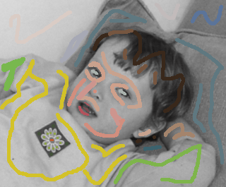
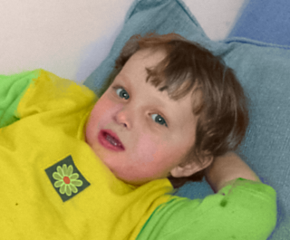
Semi-Automated Methods
Using color “Scribbles”

Slide 16
Automated methods: methods that doesn’t require any user interaction.
Paper | Authors | Year | Technique | Dataset
Colorful image colorization | Zhang , Isola and Efros | 2016 | Deep Learning (CNN) | ImageNet
Let there be color! | Satoshi Iizuka ,Edgar Simo-Serra and Hiroshi Ishikawa | 2016 | Deep Learning (CNN) | ImageNet
Deep kolorization | Federico Baldassarre, Diego Gonz´alez, Lucas Rod´es-Guirao | 2017 | Deep Learning (CNN-auto encoders) | ImageNet

Slide 17
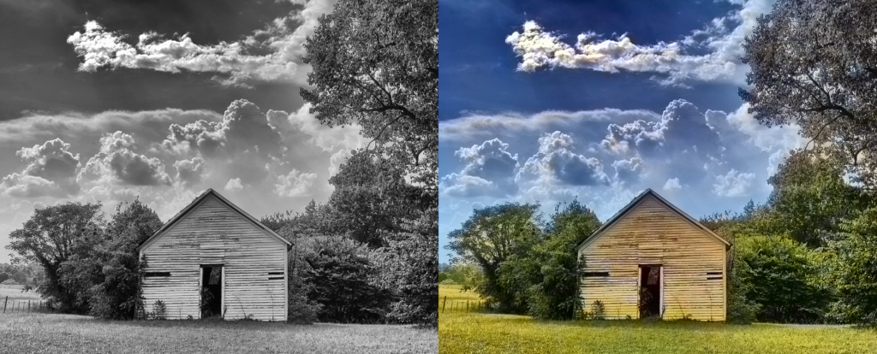
Automated Methods
Using deep learning “CNN”

Slide 18
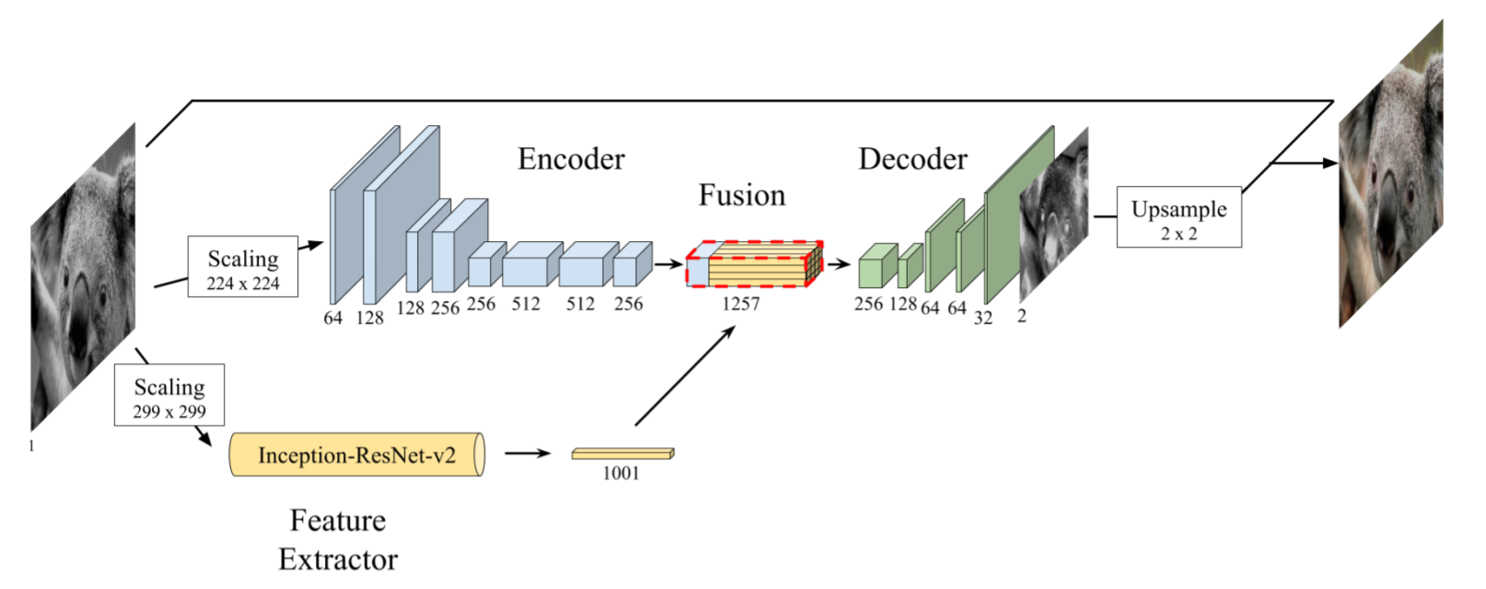
System Architecture
We made an implementation of the “deep Kolorization” paper.

Slide 19
System Architecture
“deep kolorization” Architecture :
CIE Lab color space
Inputs is “L-Channel” for encoder and inception model.
Preprocessing is “resizing and embeddings”.
Outputs is ‘ab’ channels.

Slide 20
System Architecture
Why “deep kolorization” Architecture?!
Extracting powerful Features using Inception Resnet V2 pretrained model.
Labels are simply the ab channels of the image “H * W * 2 * Samples”.

Slide 21
Dataset
Building Dataset :
Our Dataset contains 3000 images in total , including 3 categories.
We have 1000 images of Nature “Forest Road , Gardens” category from MIT Dataset
In addition to 1000 images of ImageNet Dataset of “Geological Formation (Cliff) “ category .
Finally we added 1000 images of “Historical Abbey” category we have collected from google images.

Slide 22
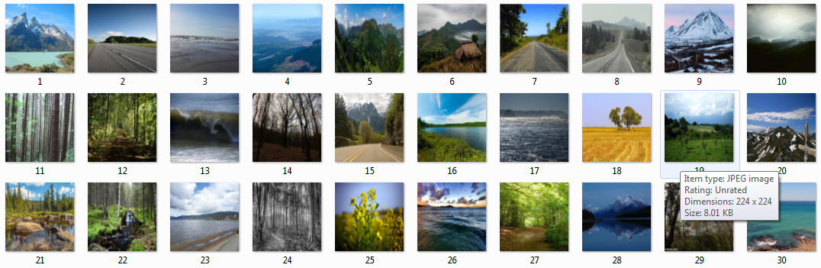
Dataset
Building Dataset :
MIT Places Scenes Dataset [Zhou+ 2014] :it has 2.3 Million training images 256 x 256 RGB [24GB] . We Used 3000 samples from “Forest Road & Nature” category, we used only 1000 images in finale phase.

Slide 23
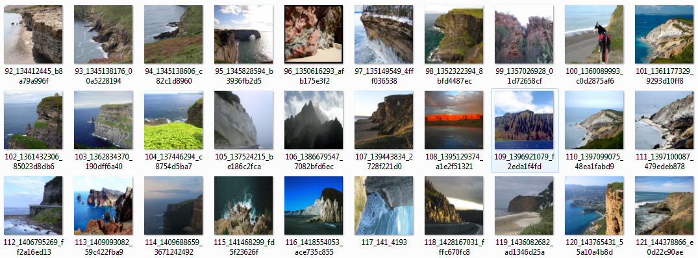
Dataset
Building Dataset :
ImageNet Dataset : it contains over 14Milion images and more than 20K synsets. We Select a category of 1500 images “Geological Formation (Cliff) ” category , we used 1000 images in final phase.

Slide 24
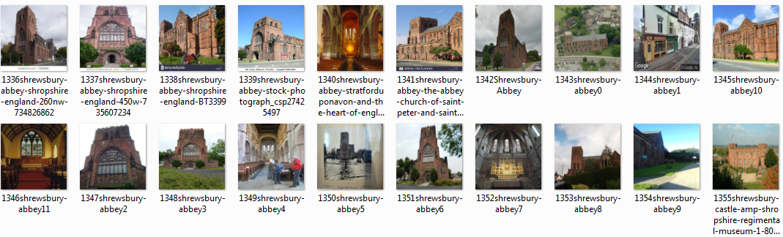
Dataset
Building Dataset :
Google Images Dataset :We collect 1000 images of “Historical Abbey ” category from google images .

Slide 25
Cloud Services
Cloud Service | Colab | Kaggle | Floydhub
CPU/GPU | Free GPU | Free GPU “Tesla K80” | Tesla K80 GPUs
Session (hours) | 12 hours | for 9 hours max | -
VRAM | 12.70 GB | 13GB | 12GB
Custom Packets | Uploaded Datasets. | Has lots of datasets | introducing public projects and datasets

Slide 26
Experiments
Architecture | Cloud Used | Dataset | Category | Optimizer | Batch Size | Learning Rate | Epochs | Validating Dataset | Validating Accuracy
Deep Kolorization | Colab | 1500 | Nature | RMSprop | 10 | 0.001 | 100 | 200 | 76.9989
Deep Kolorization | Kaggle | 3000 | Nature |  | 8 | 0.001 | 50 | 350 | 77.1020
 |  |  | Nature,Cliff,Abbey
 |  |  |  |  |  |  |  |  | 77.9866

Slide 27
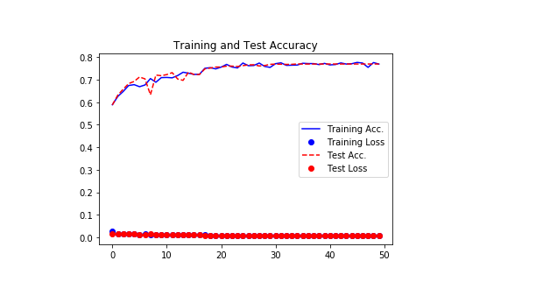
Experiments

Slide 28
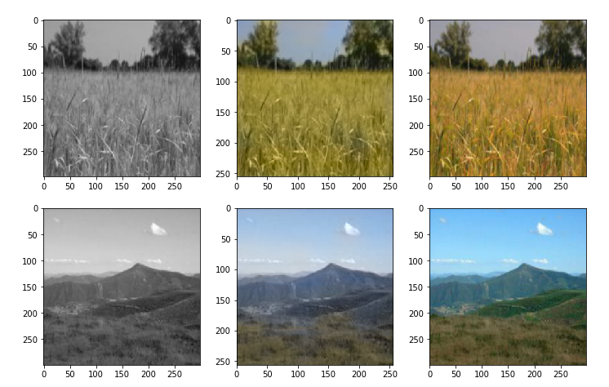
Results
Results from Nature category:
Gray Ours Ground Truth

Slide 29
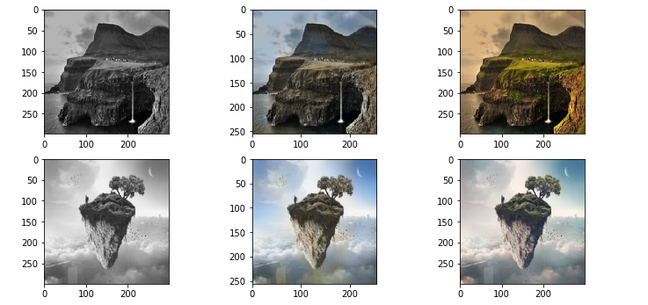
Results
Results from (Cliff) category:
Gray Ours Ground Truth

Slide 30
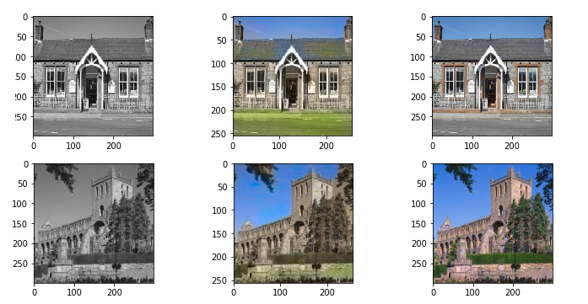
Results
Results from Abbey category :
Gray Ours Ground Truth

Slide 31
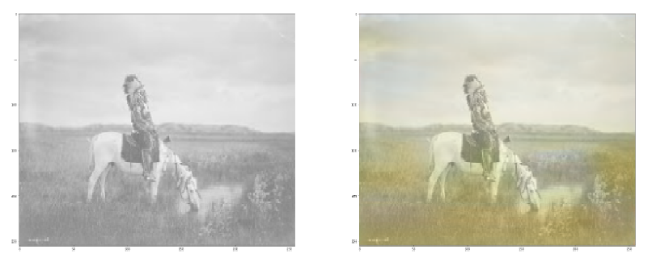
Results
Some results from historical photos:

Slide 32
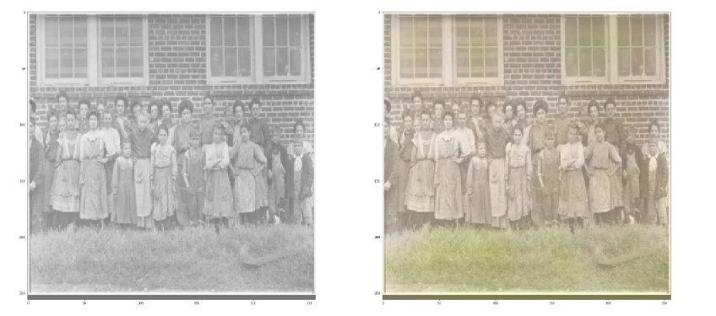
Results
Some results from historical photos:

Slide 33
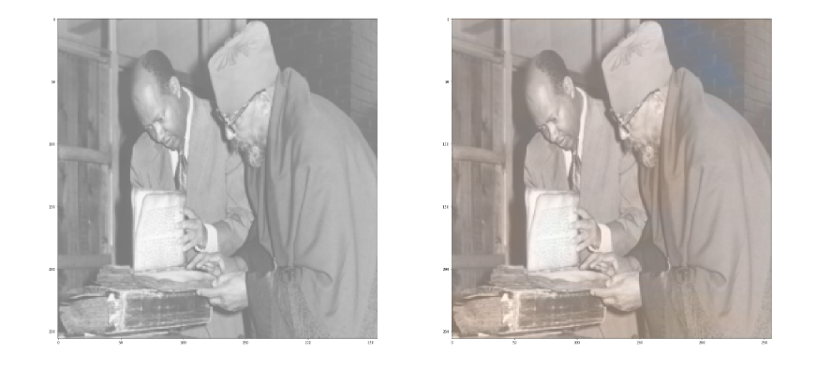
Results
Some results from historical photos:

Slide 34
Results
Here is a Demo for our testing on Kaggle..

Slide 35
Conclusion
This project validates that an Auto-encoders could be the best choice for image colorization tasks.
Our Model is able to successfully color high-level image components such as the sky, the sea or forests.

Slide 36
Future Work
We used free Cloud (Kaggle) for powerful resources , Next important step to use paid cloud resources for more control and support like Amazon or IBM cloud and to over come limited resources (GPUs, RAM, etc.) .
The performance on unseen images highly depends on their specific contents, our network should be trained over a larger training dataset containing more categories.
It could be interesting to apply colorization techniques to video sequences, which could potentially re-master old documentaries.
It is very important to design a UI in order to make the test easy for users.

Slide 37
Tools
OpenCV , Scikit-learn , matplotlib for image preprocessing.
Tensorflow, Keras API for building and training the model.

Slide 38
References
https://arxiv.org/pdf/1712.03400.pdf.
https://richzhang.github.io/colorization/resources/colorful_eccv2016.pdf
Tutorial Convolutional Neural Network based Image Colorization using OpenCV, last access date 08 Apr 2019, access link.
CoLab https://colab.research.google.com/notebooks/welcome.ipynb
Kaggle https://www.kaggle.com/
ImageNet http://image-net.org/
MIT Places http://places2.csail.mit.edu/

Slide 39

Any Questions?!

Slide 40
Thank You!

